Slide 1
Leveraging Twitter data to comprehend emotion detection and cross-cultural polarity utilising Sentiment analysis for Covid19
Project Report for COL865 - Special Topics in Computer Applications - Social Computing
Group members
Ritika Singh (2021AIZ8329)
Sweta Mahajan (2021AIZ8356)
Notes:
Sentiment Analysis (SA) is a heavy computational study into human behaviours, per- spectives, and emotional responses intrinsically as such human sentiments have all been described in terms of any entity. An element can be shown to demonstrate an incident, an individual, or maybe even a topic. SA incorporates three terminology to extract sentiment. They are : object and feature, opinion holder, and opinion and orientation. Natural Language Processing (NLP), text reviews and mathematical tools for extracting relevant information and classifying sentiments from customer reviews are indeed the paramount backbones onto which SA is built.
This project paper provides a comprehensive survey of prominent Sentiment Analysis tools and models, with the objective of submitting a concise evaluation report on which to build research work.

Slide 2
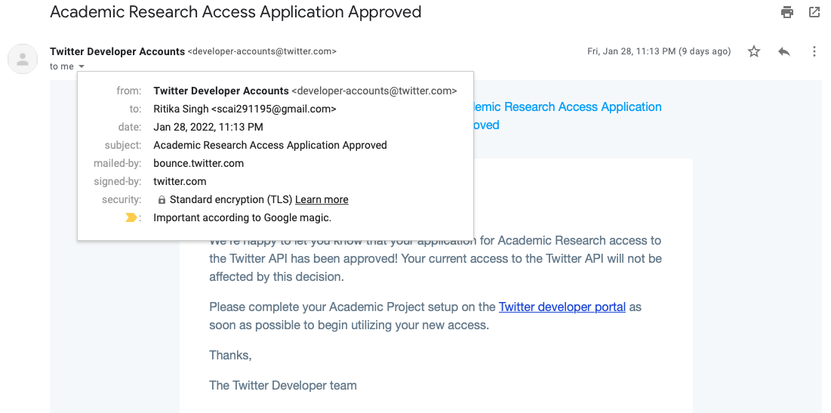
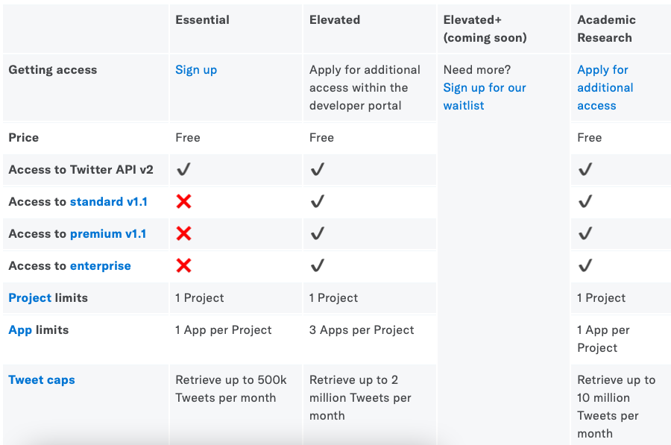
Authentication process
To use this API, a developer account on Twitter’s website must be created. A request was made to gain access to Academic Research (elevated plus).
Following verification, the following keys are received: Consumer Key, Consumer Secret, Access Token, and Access Token Secret

Slide 3

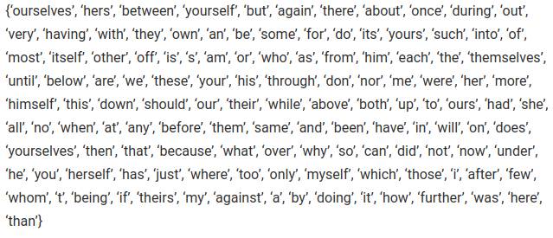
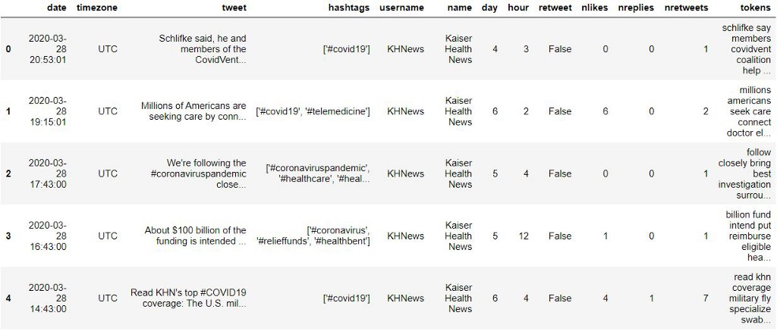
Basic Text Pre-Processing
Stop-Word Removal
Lower Casing
Stemming
Tokenization
Duplicate tweets were removed
Notes:
Tokenization: This is a process that divides a lengthy paragraph into words and phrases.
Tokenization is the process of breaking down the given text in natural language processing into the smallest unit in a sentence called a token
Lemmatization: This is the process of tracing a word back to its dictionary definition.
Tags for parts of speech It is the process of recognising a text document’s structural parts, such as verbs, nouns, adjectives, and adverbs. The interface for utilising the point-of-sale tagging capability.
Stemming is definitely the simpler of the two approaches. With stemming, words are reduced to their word stems. A word stem need not be the same root as a dictionary-based morphological root, it just is an equal to or smaller form of the word.
The aim of lemmatization, like stemming, is to reduce inflectional forms to a common base form. As opposed to stemming, lemmatization does not simply chop off inflections. Instead, it uses lexical knowledge bases to get the correct base forms of words

Slide 4
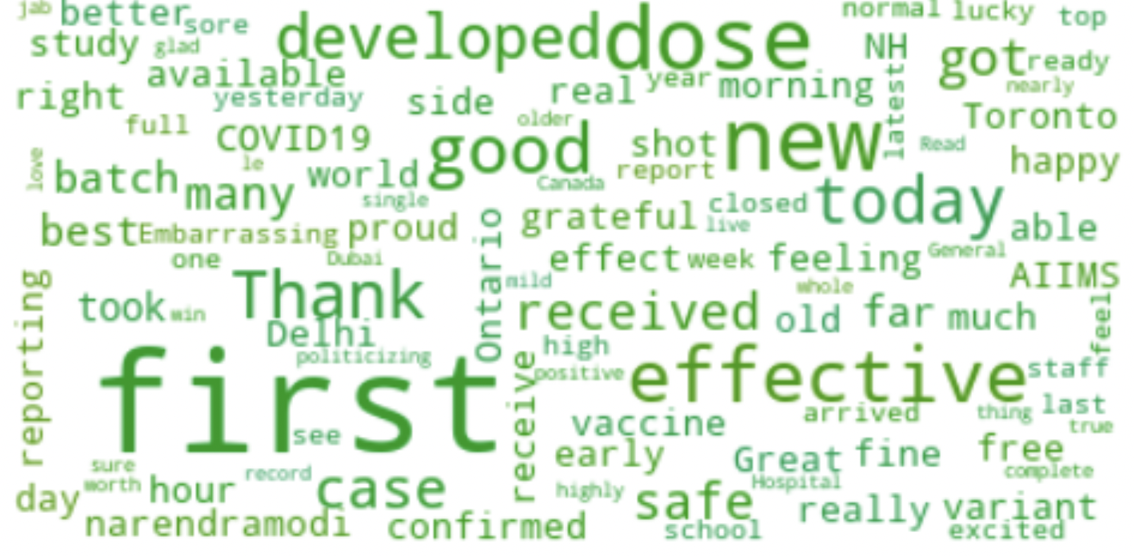

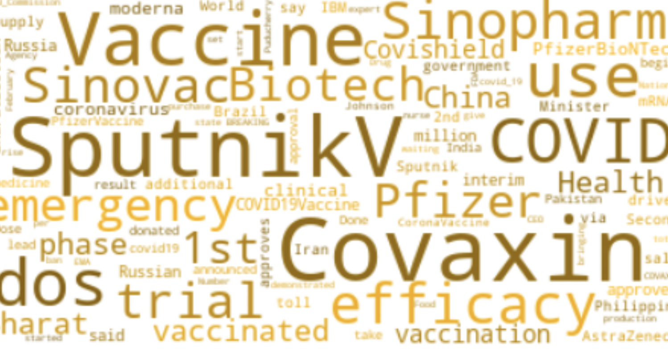
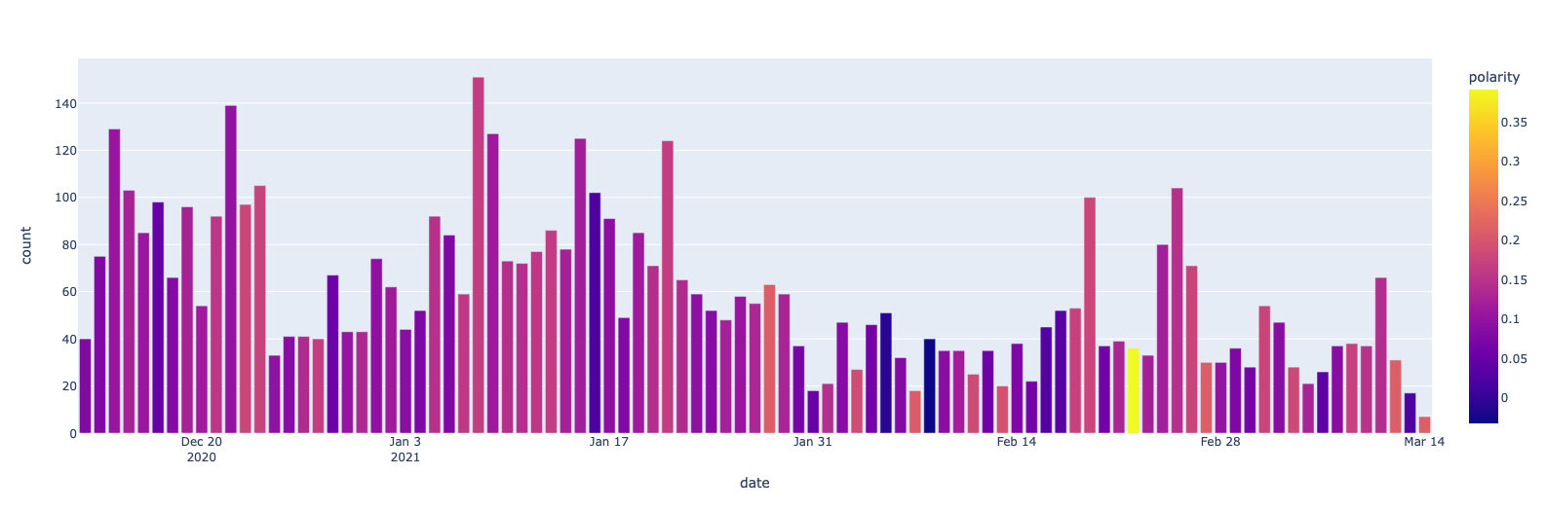
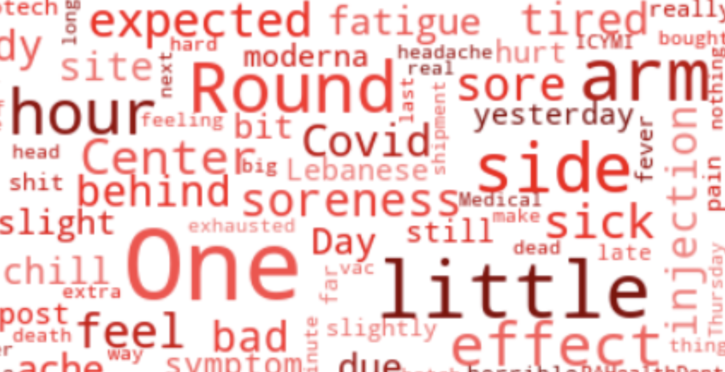
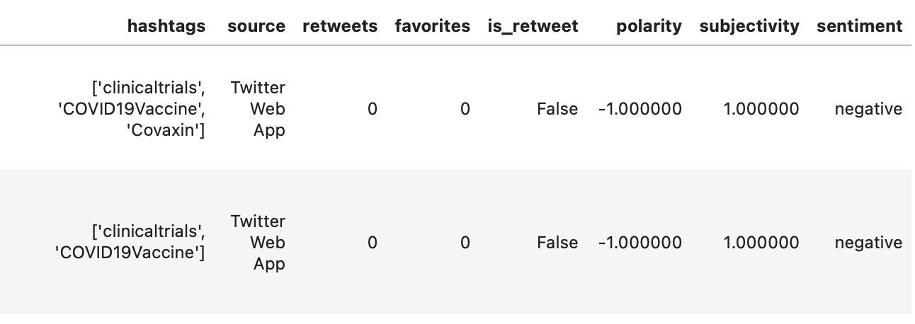
Covaxin polarity
Models Deployed TextBlob

Slide 5
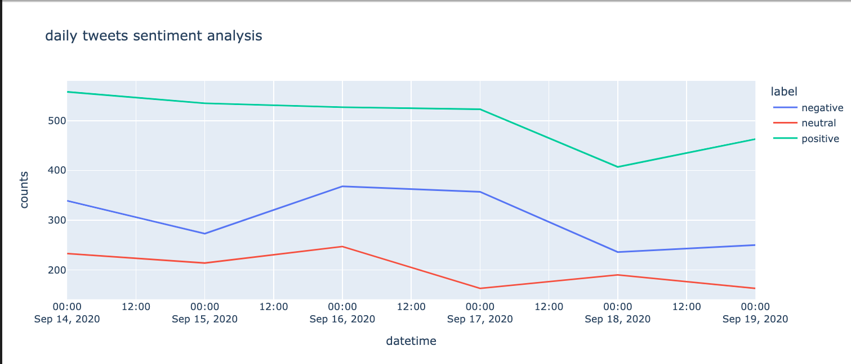
VADER
IMPLEMENTED VADER to classify text as positive, negative or neutral
Unsupervised model: maps words to emotion intensity, uses heuristics to encode how contextual information increments, decrements or negates sentiment of text
1) Handles emoji, slangs, acronyms well
2) Not good= bad

Slide 6
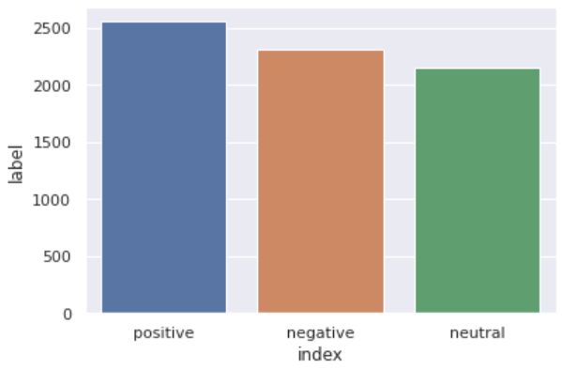
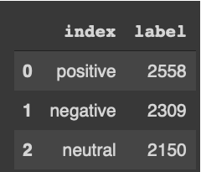
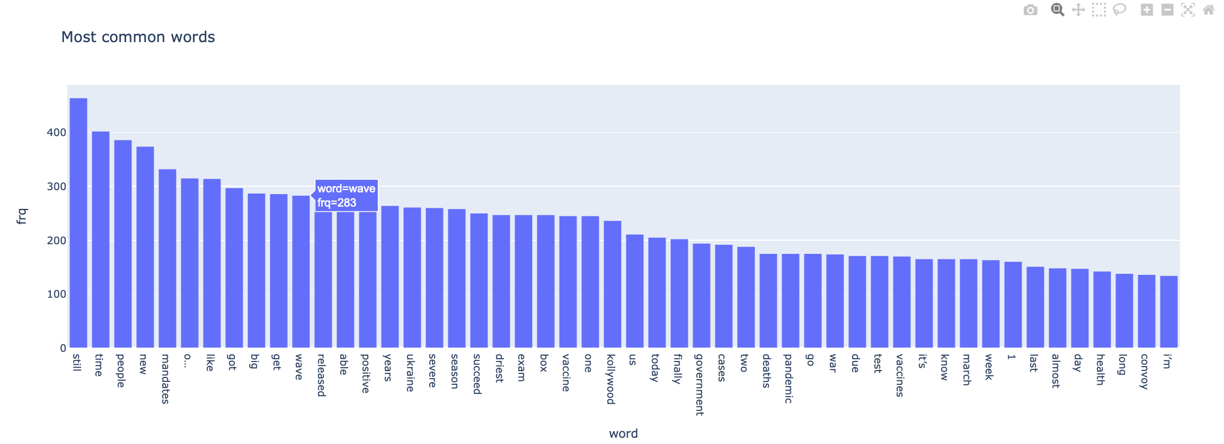
VADER
The data scraped
1) 6th to 12th may 2020 (When cases kept on increasing): 16499 tweets
2 ) First wave- 14th to 20th sept 2020 : 6046 tweets
It took ~1min to scrape 1000 tweets.

Slide 7
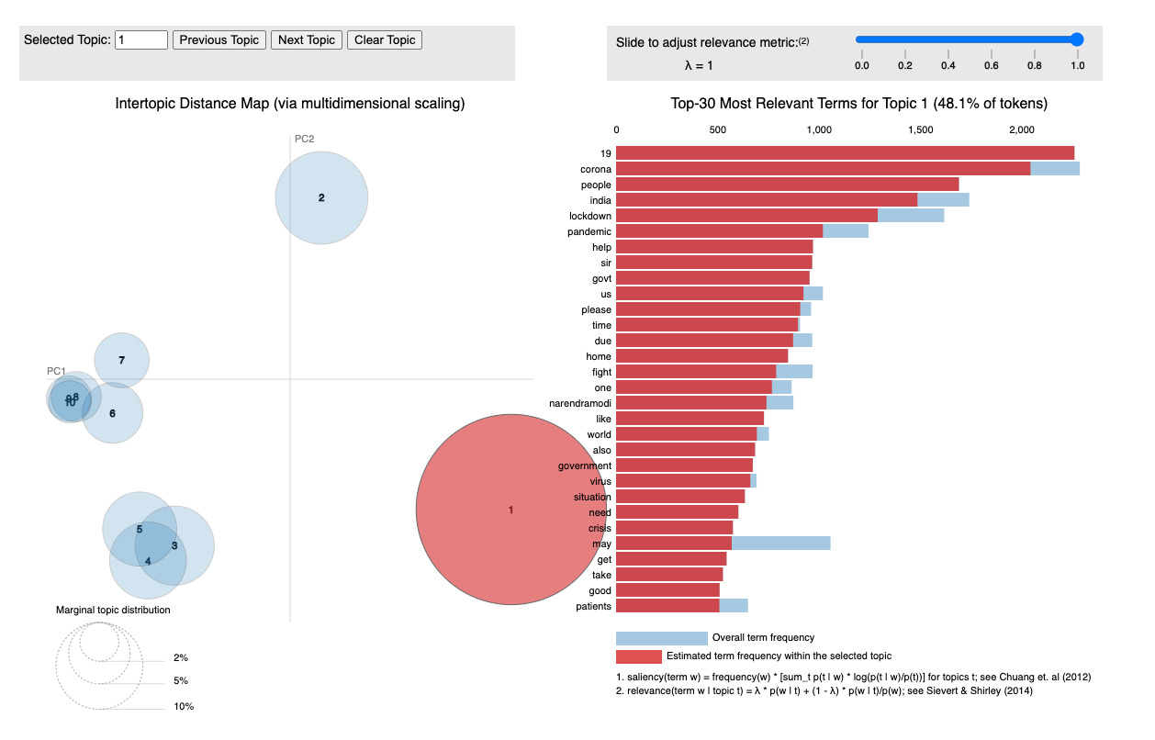
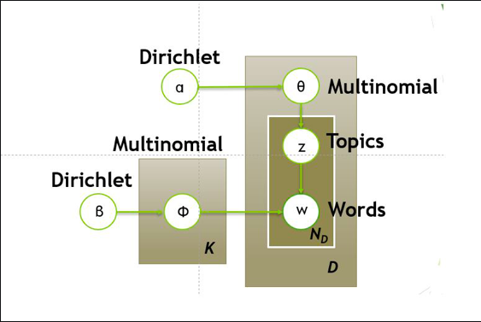
Latent Dirichlet Allocation:

Slide 8
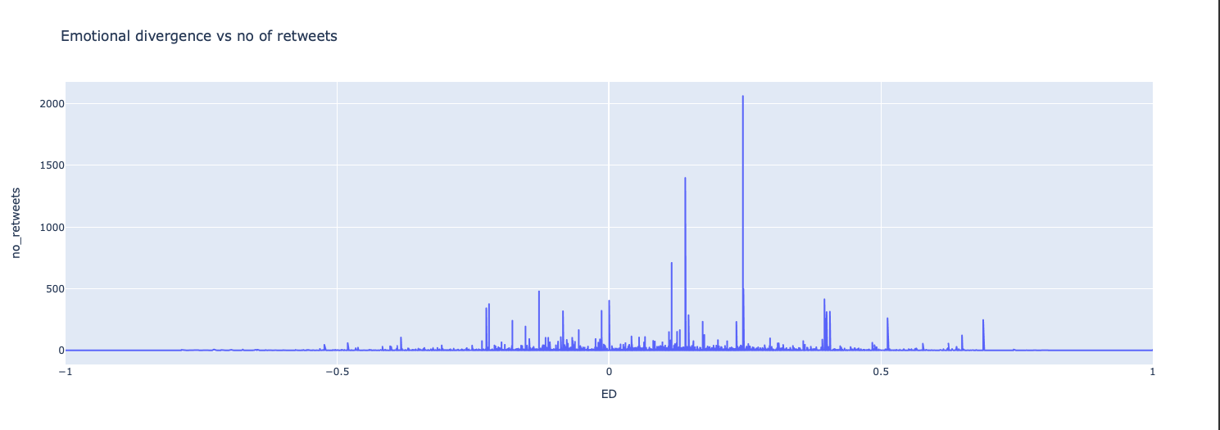
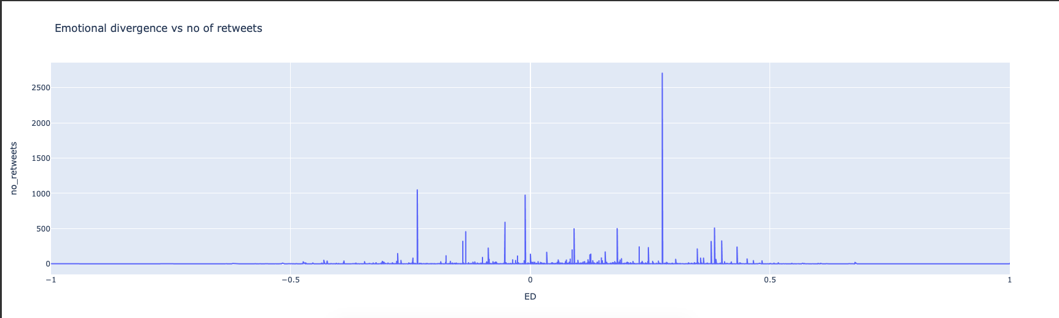

Slide 9
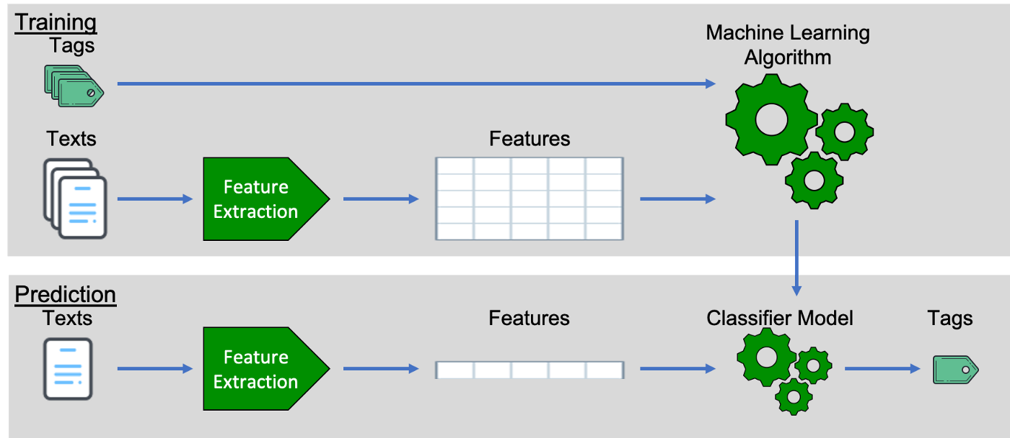
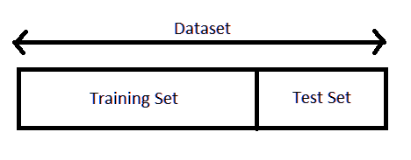
Machine Learning models
Notes:
Text data must be processed into a numeric vocabulary which can be interpreted by machine learning techniques prior all of that can be utilized. Since algorithms can only process numerical data, it is crucial to per- form this function. In principle, there exist various techniques for encoding textual in- formation into numeric form, like CountVectorizer, TfIdf, among others.
This bag of words concept is employed to construct the Count Vectorizer. It operates by calculating the frequency of instances every word occurs within every document (tweets). If term frequency-inverse document frequency (TfIdf) is employed, the quantitative results in- crease as the number of words in the collection increases, but the increase is neutralized by the occurrence of the same word in separate samples. In the specific instance of the phrase ’pandemic’ emerging many times in a document and being present in approxi- mately 80percent of total of the tweets, count vectorizer will designate a great premium to pandemic, but TfIdf will assign a negligible value to pandemic because it is a common word that appears in many documents and is therefore not a useful word to classify the tweets.

Slide 10
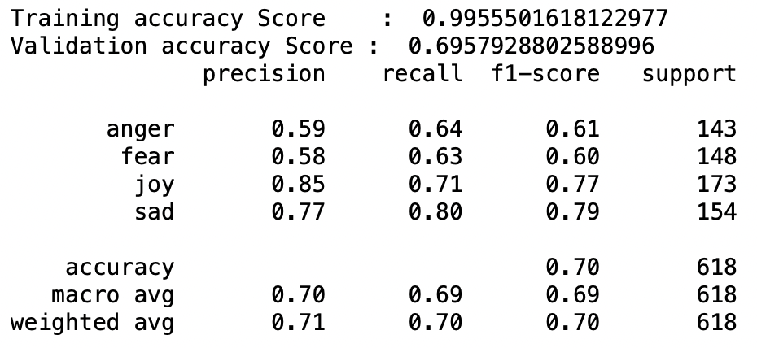
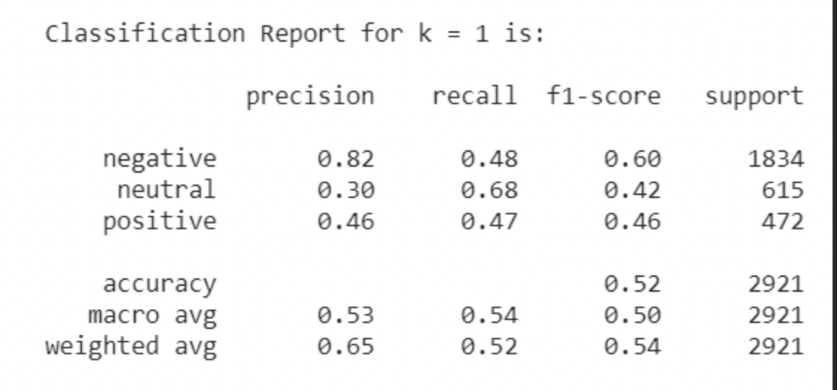
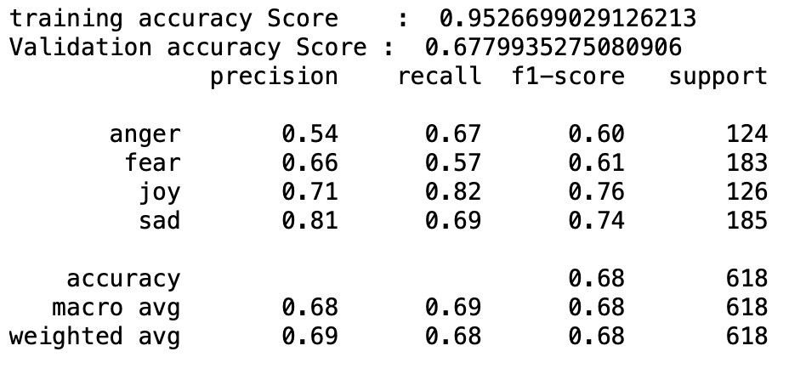
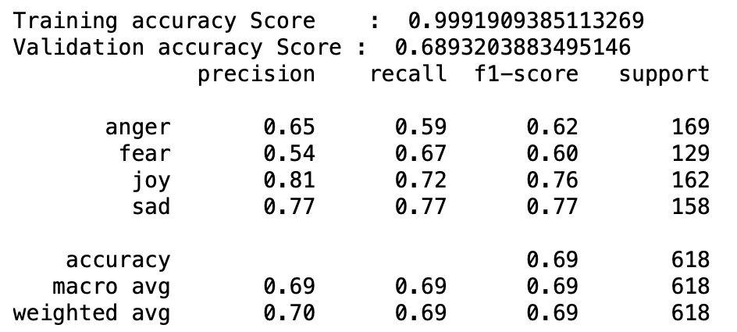
Sentiment Analysis using Logistic Regression
Sentiment Analysis using KNN Classification
Sentiment Analysis using
Multinomial Naive Bayes classifiers
Sentiment Analysis using Stochastic Gradient Descent

Slide 11

The difficulties of sentiment analysis
Recognize subjective textual elements
Detection of Sarcasm
Contradictory expressions
Explicit Negation of Sentiment
Comparative analysis.
Globalization
Notes:
Recognize subjective textual elements: Subjective textual elements contain senti- mental value. In certain cases, the same word might be considered subjective, while in others, it can be considered objective. This complicates the task of identifying subjective passages of text. For instance: 1. Mr.language Dennis’s was really crude. 2. Crude oil is extracted from seabeds. In the first example, the term ”crude” is used subjectively, however in the second example, it is fully objective.
Detection of Sarcasm: Sarcastic statements express a negative judgement about a
target in an unusual way by utilising positive words. For instance, ”Nice perfume.” You are required to shower in it.” Although the sentence contains solely good words, it conveys a negative emotion.
Contradictory expressions: There are some sentences in which only a portion of the text defines the document’s overall polarity. For instance, ”This film has the potential to be fantastic.” It sounds like an excellent plot, with well-known stars and a good supporting cast. In this situation, a straightforward bag of words technique will label it as good sentiment, yet the underlying sentiment is negative.
Explicit Negation of Sentiment: In addition to the simple no, not, never, etc., sentiment can be negated in a variety of ways. Such negations are notoriously difficult to discern. ”It eschews any suspense and predictability associated with Hollywood films.” Suspense and predictability have a negative connotation in this context, and the use of ”avoids” cancels their respective connotations.
Comparative analysis. The bag of words model does not perform well in compar- isons. For instance, ”IITs are better than the majority of private colleges,” the tweet would be judged good for both IITs and private colleges using the bag of words approach, as it omits the reference to ”better.”
Globalization: While the majority of current research focuses on English material, Twitter has a diverse user base from all over the world.

Slide 12




Thank you!

